Slide 1



FINAL REVIEW SheZone Women Safety using GeoAI
Team Members : Priya Dharshini S (2023PECCS331),
Rithika Rani B (2023PECCS350)
Co-ordinator Name : Mr.C.Elangovan,
Mr.Raveendran
Guide Name : Mrs. Jaichitra Vasudevan
Batch No : 22
SDG Goals :
. Goal 5: Gender Equality
Target 5.2: Eliminate all forms of violence against women and girls in public and private spaces.
. Goal 11: Sustainable Cities and Communities
Target 11.7: Provide universal access to safe, inclusive and accessible green and public spaces, particularly for women and children.

Slide 2
Base Paper Details
Title :
Crime Hotspot Classification using Machine Learning
Authors :
Dr Balaji G ; Kokila G
Conference: International Conference on Machine Learning and Autonomous Systems (ICMLAS-2025)
Year : 2025
Publisher : IEEE

Slide 3
Abstract
Problem Statement :
Social Problem:
. Unsafe travel is a big concern for women in cities. Fear of harassment or assault forces many to avoid jobs, schools, or late-night outings. There is no digital system that warns them in advance about dangerous places, or helps them find safer paths to walk or travel.
Data & Statistics:
. According to NCRB (2023), 4.45 lakh cases of crimes against women were reported across India—a 4% rise from 2022.
. A survey by SafetyPin found that over 60% of women avoid traveling alone at night in Indian cities.
. Most Indian cities do not show real-time crime data or safety information on maps or apps.
Summary :
. Women in India lack a real-time, location-aware safety system that predicts unsafe zones and helps them travel safely through smart route suggestions and SOS alerts.

Slide 4
Objectives :
Predict unsafe zones using historical crime data and geospatial machine learning models.
Suggest safer travel routes by considering time, location, and crime density to help women avoid high-risk areas.
Provide emergency support via SOS alerts and real-time location sharing with trusted contacts.
Recommend nearby safe places such as police stations, hospitals, and crowded public spots.
Integrate multiple safety features — crime prediction, safe routing, and emergency alerts — into a single mobile platform.
Enable real-time safety visualization using interactive maps and Google Maps API.

Slide 5
Significance :
Addresses a pressing social issue — unsafe travel for women, which limits their mobility, work, and education opportunities.
Empowers women to make informed travel decisions using live risk maps and safety insights.
Enhances emergency responsiveness with instant SOS and live tracking.
Bridges the gap between predictive safety analytics and real-time navigation.
Potential for community-driven safety through future features like user-reported incidents.
Scalable solution that can be expanded to other vulnerable groups, smart city planning, and law enforcement applications.

Slide 6
Social Relevance :
Benefits :
Improves women’s safety by predicting unsafe areas and suggesting safer travel routes.
Reduces crime risks through timely alerts and location tracking.
Empowers women’s freedom of movement, allowing them to work, study, and travel without fear.
Creates awareness about high-risk zones for the public.
Supports emergency response with quick SOS alerts to trusted contacts.
Helps law enforcement identify and monitor crime-prone areas.

Slide 7
.
Link to Relevant SDGs :
SDG 5 – Gender Equality (Target 5.2): Helps eliminate violence against women by providing preventive and emergency safety tools.
SDG 11 – Sustainable Cities and Communities (Target 11.7): Promotes safe, inclusive, and accessible public spaces for women and vulnerable groups.
Importance in Solving a Real-World Problem :
Addresses the rising crime rates against women in India (4.45 lakh cases in 2023 – NCRB data).
Fills the gap of real-time safety navigation systems, which most cities currently lack.
Combines predictive analytics + emergency response in one platform, unlike existing safety apps.
Builds trust and safety in urban travel, contributing to social well-being and economic participation of women.

Slide 8
Introduction
In recent years, women’s safety has become a critical concern, especially in urban areas where the risk of harassment and assault is higher during travel. Many women avoid night shifts, certain routes, or even job opportunities due to safety fears.
According to NCRB (2023), over 4.45 lakh crimes against women were reported in India, marking a 4% rise from the previous year. Despite technological advancements, most cities lack real-time safety navigation systems that can predict unsafe zones and guide women to safer paths.
The motivation behind SheZone is to bridge this gap by creating an AI-powered safety platform that not only predicts crime-prone areas using historical data but also suggests safe routes, sends SOS alerts, and connects users with nearby safe places. This initiative aligns with the vision of empowering women, enhancing public safety, and supporting the UN Sustainable Development Goals (SDG 5 & SDG 11).

Slide 9
Literature Survey
Crime Aware Path Recommendation (IJCA, 2019) – Suggested safe walking routes using crime data and Google Maps API, integrating weighted graphs and heatmaps for risk avoidance.
Use of Machine Learning in Crime Forecasting – Applied Random Forest, K-Means, and SVM to predict crime based on time, location, and socio-economic indicators.
Technologies in Real-Time Safety Apps – Showed that Firebase, Flutter, and Google Maps API enable cross-platform, real-time safety applications.
RescueNow: Real-Time SOS and Predictive Women’s Safety System (IJSREM, Oct 2024) – Combined predictive analysis with instant SOS alerts for women’s safety.
Women Security Application Using Smart Emergency Response System (ResearchGate, 2023–2024) – Developed a real-time location tracking and smart alert system for women’s security.
SafeRoutes: Secure Path Planning for Women Using Clustering and GPS – Applied clustering algorithms with GPS data to avoid unsafe areas.
Enhancing Smart City Safety – AI Expert Systems for Violence Detection (MDPI) – Used AI systems for real-time violence detection in smart cities.

Slide 10
.
Crime Hotspot Prediction Using Deep Graph Convolutional Networks (arXiv, 2025) – Applied graph neural networks for predicting spatial crime patterns.
Spatial-Temporal Hypergraph Self-Supervised Learning for Crime Prediction (arXiv, 2022) – Applied hypergraph learning for improved crime forecasting.
Graph Representation Learning for Street-Level Crime Prediction (MDPI) – Used graph representation methods for fine-grained crime predictions.
Geospatial Analysis of Crime Against Women (ResearchGate, 2023) – Applied GIS mapping to analyze and visualize women-related crimes.
Geospatial Crime Analysis and Prediction (GitHub Project) – Used machine learning and spatial data for crime hotspot detection.
Analysis and Prediction of Crimes Against Women (GitHub Project) – Focused on predicting crime patterns using ML algorithms and crime datasets.
Women Safety App with Location Sharing and Alerts (GitHub Project) – Demonstrated mobile app integration for real-time alerts and GPS tracking.
OpenStreetMap & OSMnx for Urban Safety Mapping – Leveraged open geospatial data for safety route planning.
Google Maps & Places API for Safety Applications – Integrated place recommendations like police stations and hospitals in real-time navigation.
Geospatial Analysis (Textbook) – Offered theoretical foundations for applying spatial data to safety and crime mapping.

Slide 11
Proposed System (Architecture explanation)
Data Sources:
NCRB Crime Data (2023)
OpenStreetMap
Google Places API
Backend:
Python (Pandas, GeoPandas)
Feature Extraction (Time, Location, Crime Type)
Random Forest (Risk Prediction)
DBSCAN / K-Means (Unsafe Zone Detection)
Folium for Risk Mapping
Frontend:
Flutter Mobile App
Real-time Risk Map
Safe Route Suggestions
SOS & Live Tracking
Safe Place Recommender
Cloud Services/APIs:
Firebase (Location & Alerts)
Google Maps API

Slide 12
Hardware & Software Specifications
Hardware Requirements :
Processor: Intel Core i3 or higher (for backend & frontend development)
RAM: Minimum 4 GB (8 GB recommended for smooth ML model training)
Storage: 500 GB HDD / 128 GB SSD (for datasets & application files)
Graphics: Basic integrated GPU (map rendering & UI)
Mobile Device: Android/iOS smartphone (for Flutter app & SOS testing)
Internet Connectivity: Mandatory for real-time API access, location tracking, and SOS alerts

Slide 13
Software Requirements :
Data Sources & APIs:
NCRB Crime Data (2023) – Historical crime dataset
OpenStreetMap + OSMnx – Geospatial mapping data
Google Places API – Safe place recommendations
Backend:
Python (Pandas, GeoPandas) – Data preprocessing & feature extraction
Random Forest – Crime risk prediction
DBSCAN / K-Means – Unsafe zone detection
Folium – Interactive risk mapping
Frontend:
Flutter Mobile App – Real-time risk map, safe route suggestions, SOS & live tracking
Dart – Flutter app programming
Cloud Services:
Firebase – Real-time location tracking, authentication, SOS alert system
Google Maps API – Map display & safe routing

Slide 14
Development Tools:
VS Code / PyCharm – Backend development
Android Studio – Flutter app testing & debugging
Google Colab / Jupyter Notebook – ML model training
GitHub – Version control
Emergency SOS Feature – One-tap button to send real-time location and safety alert to trusted contacts via Firebase Cloud Messaging.

Slide 15
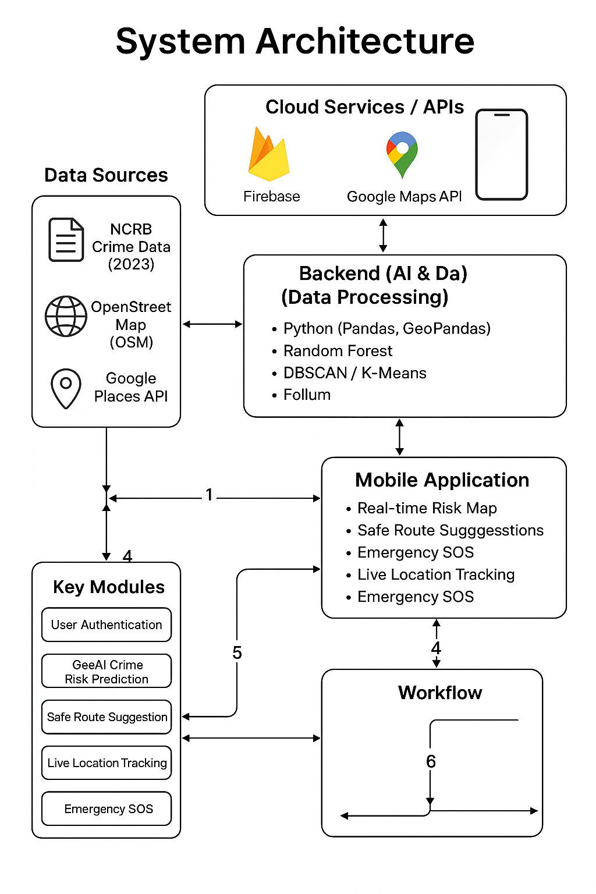

Slide 16
Modules explanation
User Authentication Module :
Secure sign-up, login, and user management.
Geo AI Crime Risk Prediction Module :
Predicts and shows safe/unsafe zones using machine learning.
Safe Route Suggestion Module :
Suggests the safest path by avoiding high-risk areas.
Live Location Tracking Module :
Tracks the user’s real-time location for navigation and safety
Emergency SOS Module :
One-tap emergency button to alert trusted contacts with location and message.

Slide 17

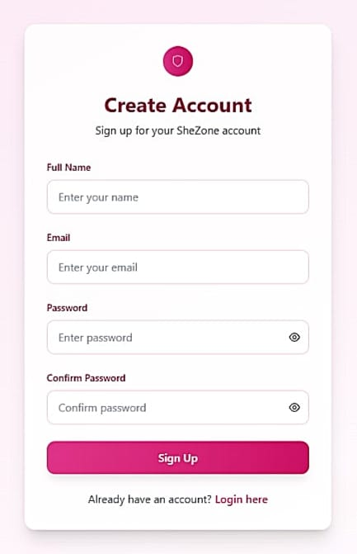
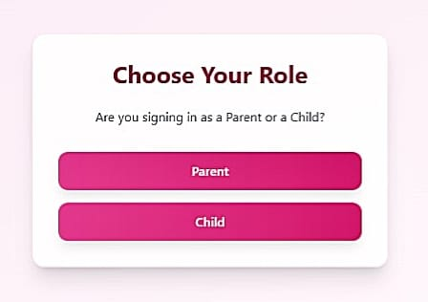
Screenshots
.

Slide 18
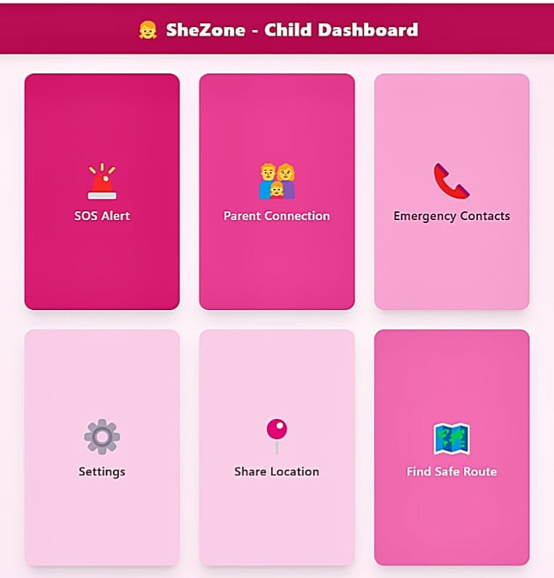
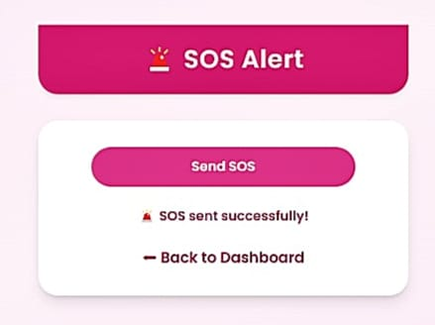


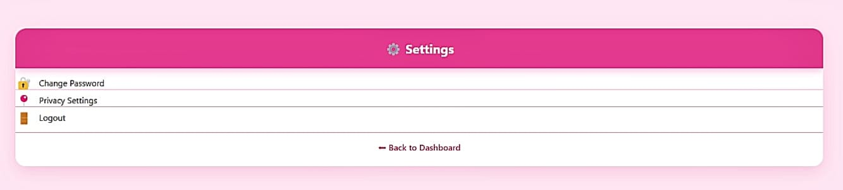

Slide 19
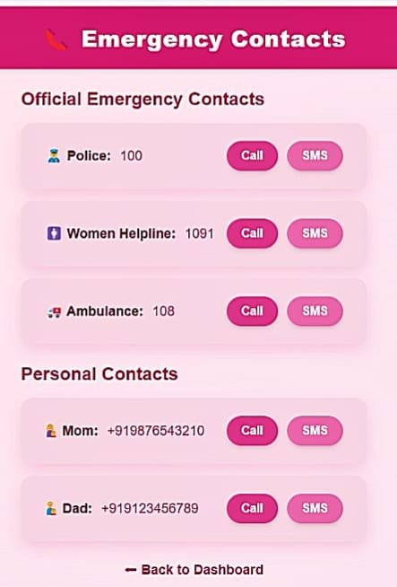

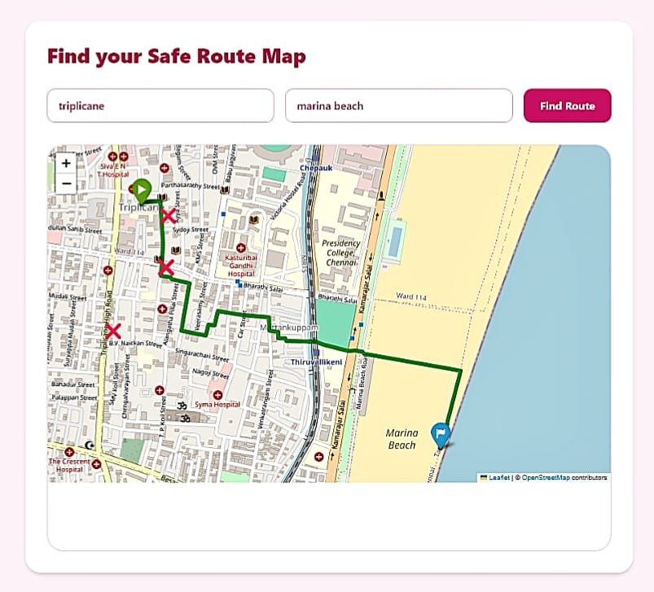
.
.

Slide 20

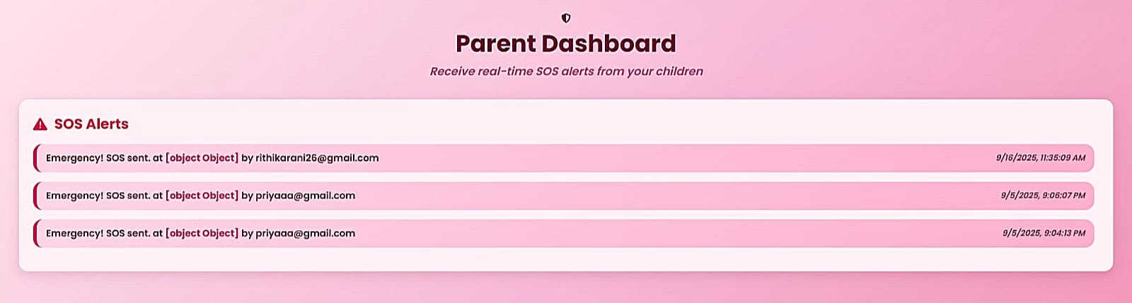

.
.

Slide 21


Slide 22
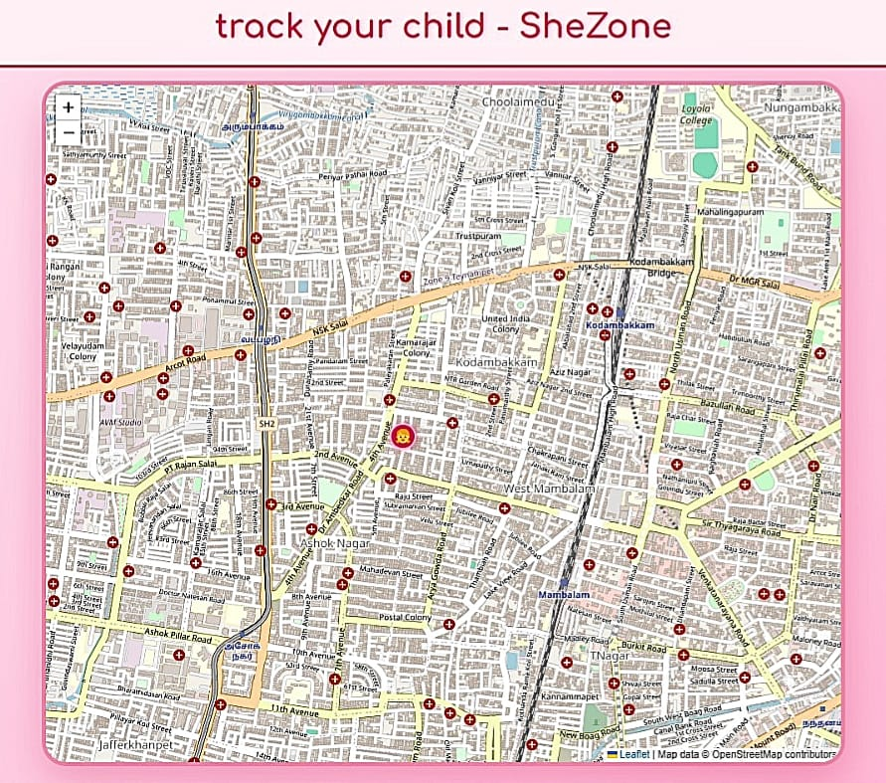

Slide 23
Conclusion and Future scope
Conclusion :
SheZone is an AI-based safety app that predicts unsafe areas, suggests safe routes, and provides SOS alerts with live tracking. It helps women travel safely, increases awareness about risky zones, and supports quick emergency response.
Future Scope :
Add user-reported safety incidents.
Voice assistant for safety updates.
Direct link to police emergency systems.
Smartwatch integration for quick SOS.
Use data to help city planners improve safety.
Extend to children, elderly, and night-shift workers.

Slide 24
References
Base Papers:
IEEE, Springer, MDPI, Elsevier papers on crime prediction, GeoAI, and safety apps (2023–2025)
. RescueNow: Real‑time SOS and Predictive Women’s Safety System (Oct 2024)
https://ijsrem.com/download/rescuenow-real-time-sos-and-predictive-womens-safety-system/
. Women Security Application Using Smart Emergency Response System and Real‑Time Location Tracking (ResearchGate, 2023–2024)
https://www.researchgate.net/publication/390739225_Women_Security_Application_Using_Smart_Emergency_Response_System_and_ReaTime_Location_Tracking
. SafeRoutes: Secure Path Planning for Women Using Clustering and GPS
https://www.researchgate.net/publication/360732358_Artificial_intelligence_based_women_security_and_safety_measure_system
.Enhancing Smart City Safety – AI Expert Systems for Violence Detection
https://www.mdpi.com/1999-5903/16/2/50
. Crime Hotspot Prediction Using Deep Graph Convolutional Networks
https://arxiv.org/abs/2506.13116

Slide 25
.
. Explainable Spatio-Temporal Graph Neural Networks (STExplainer)
https://arxiv.org/abs/2310.17149
. Spatial-Temporal Hypergraph Self-Supervised Learning for Crime Prediction
https://arxiv.org/abs/2204.08587
. Graph Representation Learning for Street-Level Crime Prediction
https://www.mdpi.com/2220-9964/13/7/229
. Geospatial Analysis of Crime Against Women
https://www.researchgate.net/publication/375873416_Geospatial_Analysis_of_Crime_Against_Women
GitHub Projects:
. github.com/Mayureshd-18/Geospatial-crime-analysis-and-prediction
. github.com/varshini67t/Analysis-and-prediction-of-crimes-against-women
. github.com/VikasiniS37/Women_safety_app
Datasets & Resources:
. NCRB crime reports – https://ncrb.gov.in
. OpenStreetMap + OSMnx
. Kaggle datasets
. Google Maps & Places APIs
. Textbooks: Geospatial Analysis, Hands-On ML by Aurélien Géron

Slide 26
THANK YOU

